Slide 1
Chongqing University of Technology
ATAI
Advanced Technique of Artificial Intelligence
Chongqing University of Technology
Semantic Graphs for Generating Deep Questions
——ACL 2020
Code：https://github.com/WING-NUS/SG-Deep-Question-Generation
2020.11.09 • ChongQing
Reported by Sijin Liu

Slide 2
Chongqing University of Technology
ATAI
Advanced Technique of Artificial Intelligence
Chongqing University of Technology
1.Introduction
2.Method
3.Experiments
4.Conclusion

Slide 3
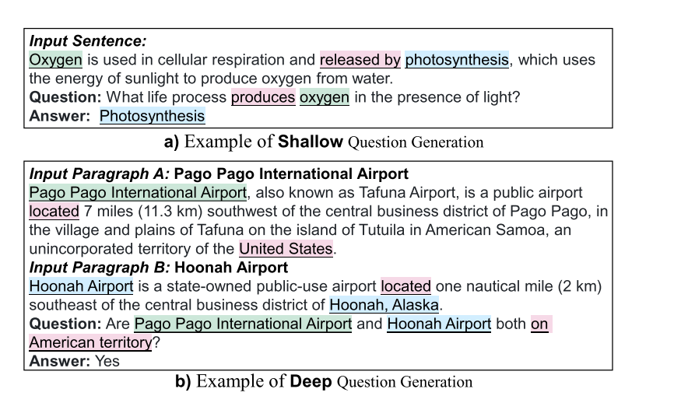
Introduction
Existing QG research has typically focused on generating factoid questions relevant to one fact obtainable from a single sentence. However, less explored has been the comprehension and reasoning aspects of questioning, resulting in questions that are shallow.

Slide 4
Introduction
Relative work
（1）these past approaches only consider sentence-level QG. In contrast, this work focus on the challenge of generating deep questions with multi-hop reasoning over document-level contexts.
（2）in practice, semantic structure is difficult to distil solely via self-attention over the entire document.
（3）despite considering longer contexts, past works are trained and evaluated on SQuAD (Rajpurkar et al., 2016), which we argue as insufficient to evaluate deep QG because more than 80% of its questions are shallow and only relevant to information confined to a single sentence

Slide 5
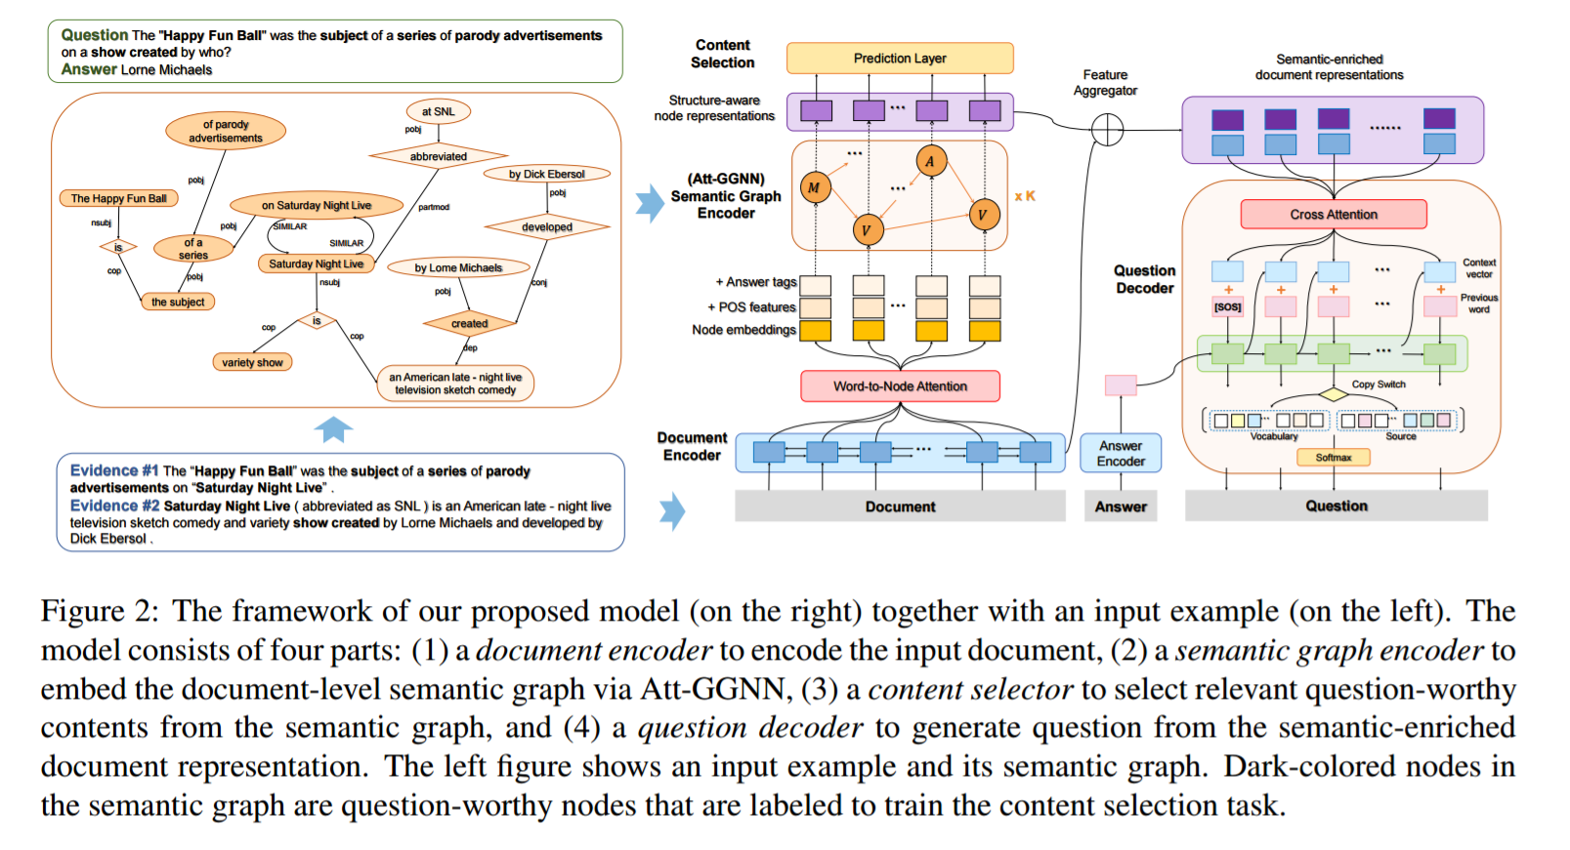
Method

Slide 6
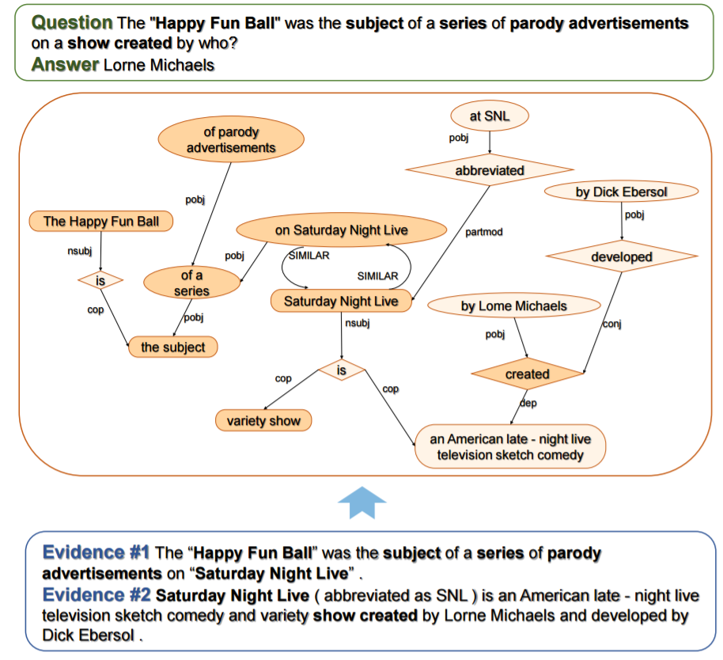
Method
Semantic Graph Construction
• SRL-based Semantic Graph.
The task of Semantic Role Labeling (SRL) is to identify what semantic relations hold among a predicate and its associated participants and properties.
• DP-based Semantic Graph.
Employ the biaffine attention for each sentence to obtain its dependency parse tree.

Slide 7
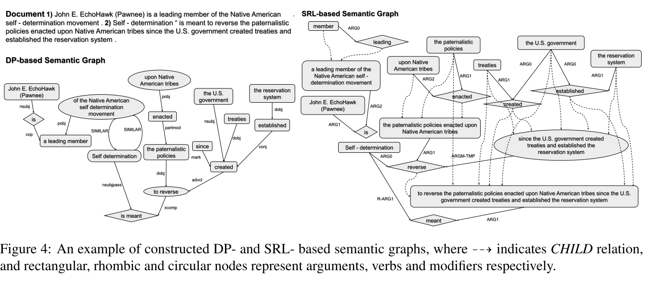
Method

Slide 8
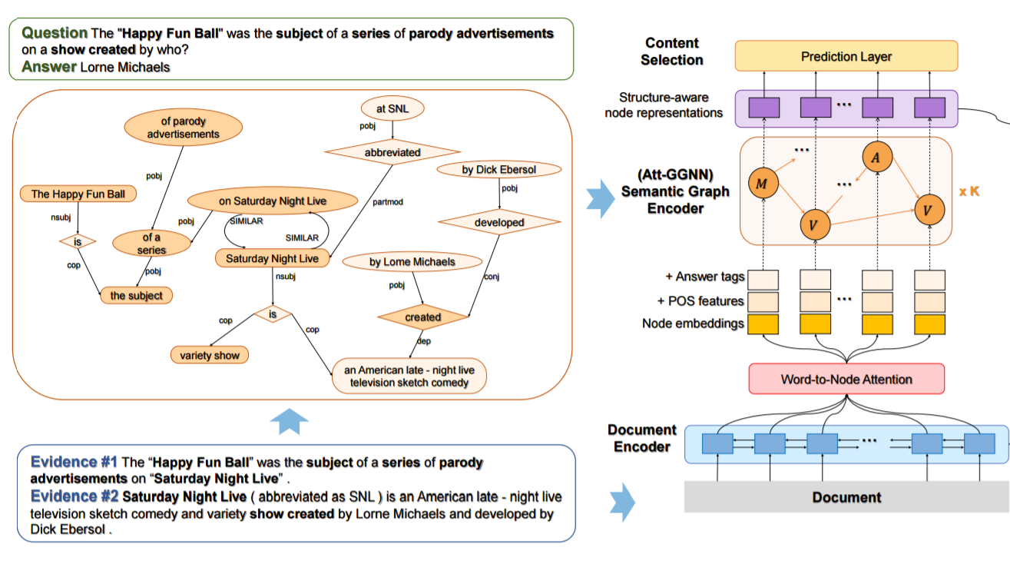
Method
Semantic-Enriched Document Representations
Separately encode the document D and the semantic graph G via an RNN-based passage encoder and a novel Att-GGNN graph encoder, respectively, then fuse them to obtain the semantic-enriched document representations for question generation.

Slide 9
Method
Semantic-Enriched Document Representations
Document Encoding
where is the context embedding of as a concatenation of its bi-directional hidden states.

Slide 10
Method
Semantic-Enriched Document Representations
Node Initialization
The semantic graph of the document is a heterogeneous multi-relation graph
and are the numbers of nodes and edges in the graph
Each node is a text span in with an associated node type , where is the starting / ending position of the text span. Each edge also has a type that represents the semantic relation between nodes

Slide 11
Method
Semantic-Enriched Document Representations
Node Initialization
as document representation

Slide 12
Method
Semantic-Enriched Document Representations
Graph Encoding
Employ a novel Att- GGNN to update the node representations by aggregating information from their neighbors. Base on the multi-relation Gated Graph Neural Network (GGNN) and Graph Attention Networks.

Slide 13
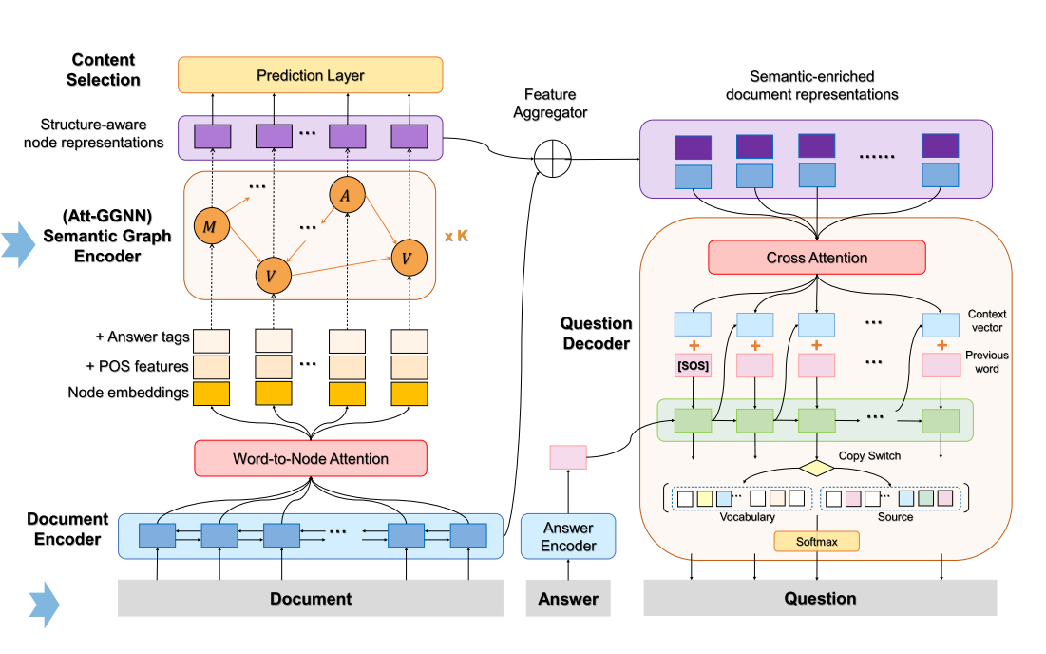
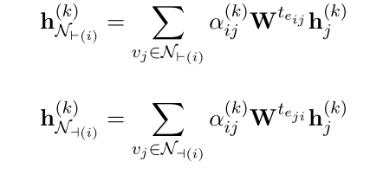
Method
Semantic-Enriched Document Representations
Graph Encoding
K layers of state transitions

Slide 14
Method
Semantic-Enriched Document Representations
Feature Aggregation
For a word , we match it to the smallest granularity node that contains the word , denoted as . We then concatenate the word representation with the node representation , i.e.,
.When there is no corresponding node , we concatenate with a special vector close to .

Slide 15
Method
Joint Task Question Generation
Question Decoding
as the attention memory
Use the average word embeddings in the answer to initialize the decoder hidden states
At each decoding step t,
Compute a context vector based on and the current decoding state .
The copying probability is calculated from the context vector , the decoder state and the decoder input .
Maintain a coverage vector , which is the sum of attention distributions over all previous decoder steps.

Slide 16
Method
Joint Task Question Generation
We formulate this as a node classification task, i.e., deciding whether each node should be involved in the process of asking.
Content Selection

Slide 17
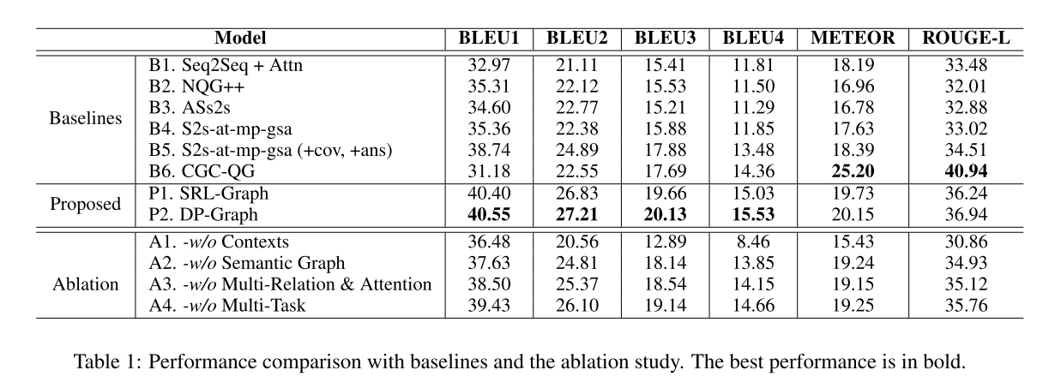
Experiments

Slide 18
Experiments

Slide 19
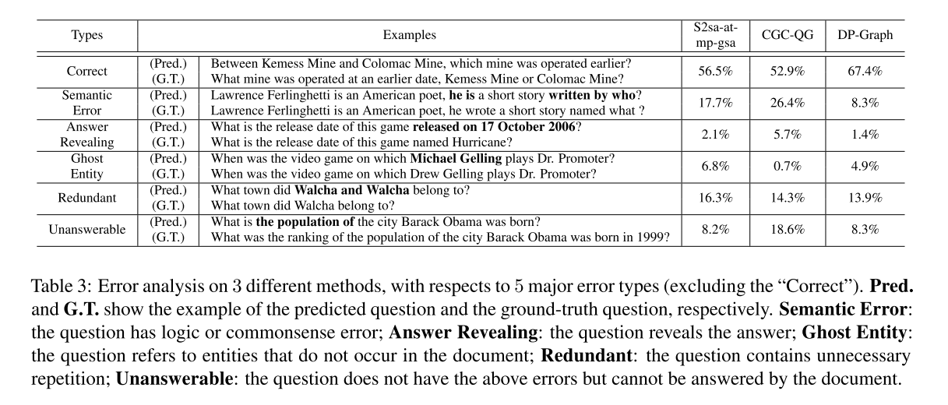
Experiments

Slide 20
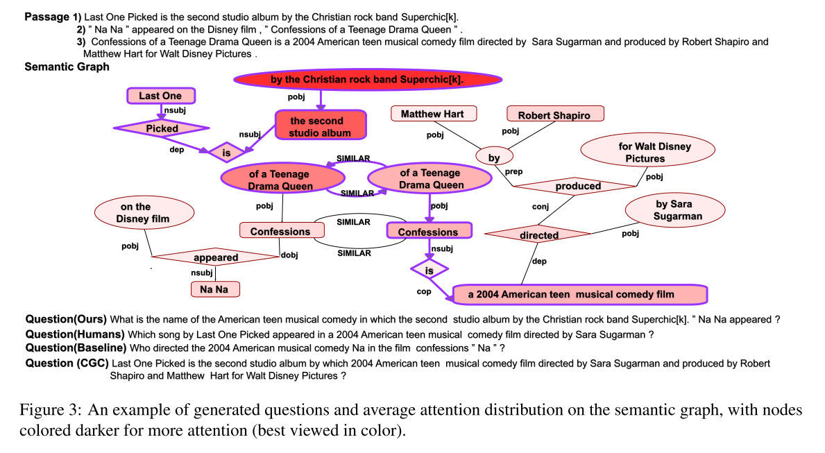
Experiments

Slide 21
Summary
This work propose the problem of DQG to generate questions that requires reasoning over multiple disjoint pieces of information. To this end, we propose a novel framework which incorporates semantic the HotpotQA dataset demonstrate that introducing semantic graph significantly reduces the semantic errors, and content selection benefits the selection and reasoning over disjoint relevant contents, leading to questions with better quality.

Slide 22
Thank you!

